Slide 1


Slide 2
Introduction to Servlet

Slide 3
Servlet
Servlet can be described in many ways depending on the context.
Servlet is a technology i.e. used to create web application. It was created by a third party but later in 1998 became part of Java.
It is very first Java based server side programming language.
Servlet is an API that provides many interfaces and classes including documentation.
Servlet is a class that extend the capabilities of the servers and respond to the incoming requests. It can respond to any type of requests.
Servlet is a web component that is deployed on the server to create dynamic web pages.

Slide 4
Servlet Lifecycle using GenericServlet
Start Tomcat
First request for Servlet
From second request onwards
Reads all web.xml available in webapps folder
Create object for requested Servlet
Creates the thread for previously created object
Calls init method to initialize Servlet
Shutdown Tomcat
Calls service method
Calls destroy method to de-alocate resources
Response send back to browser

Slide 5
Servlet Lifecycle using HTTPServlet
Start Tomcat
First request for Servlet
From second request onwards
Create object for requested Servlet
Reads all web.xml available in webapps folder
Calls init method to initialize Servlet
Creates the thread for previously created object
Calls service method
Shutdown Tomcat
Call doGet or doPost methods
Calls destroy method to deaalocate resources
Response send back to browser

Slide 6
Methods of Servlet Interface
Public void init(ServletConfig con): This method is called by web container only once in order to initialize the Servlet.
Public void service (ServletRequest req, ServletRespeonse res): This method called by web container again and again for each incoming client request in order to execute the Servlet. Business logic for a specific application can be written inside this method.
Public void destroy(): This method is also called by web container only once before destroying the Servlet object from memory.
Public String getServletInfo()
Public ServletConfig getServletConfig()

Slide 7
Servlet Life Cycle
The web container maintains the life cycle of a servlet instance.
Servlet class is loaded: The classloader is responsible to load the servlet class. The servlet class is loaded when the first request for the servlet is received by the web container.
Servlet instance is created: The web container creates the instance of a servlet after loading the servlet class. The servlet instance is created only once in the servlet life cycle.
init() method is invoked to initialize: The web container calls the init method only once after creating the servlet instance. The init method is used to initialize the servlet. It is the life cycle method of the javax.servlet.Servlet interface.
service() method is invoked: The web container calls the service method each time when request for the servlet is received. If servlet is not initialized, it follows the first three steps as described above then calls the service method. If servlet is initialized, it calls the service method. Notice that servlet is initialized only once.

Slide 8
Servlet Life Cycle
5. destroy() method is invoked: The web container calls the destroy method before removing the servlet instance from the service. It gives the servlet an opportunity to clean up any resource for example memory, thread etc.
There are three states of Servlet:
New (before invoking the init () method)
Ready (After invoking the init () method)
End (After invoking the destroy () method )

Slide 9
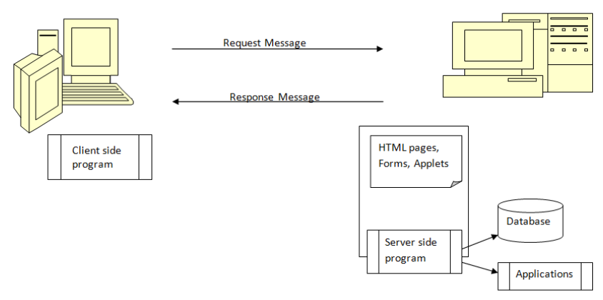
Servlet

Slide 10
THANK YOU

